Slide 1
Secular stagnation and growth in EU periphery and super-periphery
Will Bartlett (LSE)
Ivana Prica (Faculty of Economics, Belgrade)

Slide 2
Core, periphery and super-periphery
Eurozone crisis as a structural imbalance between core and periphery countries
  Germany at centre of “core” group of countries
  Greece, Italy, Portugal and Spain as “inner periphery”
  Western Balkans as “super-periphery” (Martin Sokol, 2001)

Slide 3
Spillover of the Eurozone crisis
The SEE countries have suffered from the spill-over effects of the eurozone crisis
Just like the EU periphery, they cannot devalue their way out of recession due to euroisation
  But bailouts are unavailable to these countries except through IMF stand-by arrangements which impose austerity programmes
  Therefore, the only option is internal devaluation and structural reform

Slide 4
Secular stagnation
Insufficient sources of aggregate demand
Escaping stagnation
  Government expenditure
  Exports and competitiveness
  Financialisation
Eurozone core and periphery
  Structural imbalances of the eurozone
Western Balkans as super-periphery

Slide 6
Core and periphery
Eurozone core-periphery model
“Core” growth is propelled by exports to the EU
  Generates trade surplus in the core countries
“Peripheral” countries act as consumers of core-country exports
  Generates trade deficits in the periphery
  These deficits are financed by borrowing from banking sector in the core countries largely through sale of government bonds
  These have now been largely absorbed by ECB and ESFS, communalising the debt

Slide 7
Unstable equilibrium
This is an unstable equilibrium as debts in the periphery grow ever higher and eventually cannot be financed
  The periphery cannot export its way out of debt through devaluation, due to the fixed currency
  The only alternatives are (a) bailouts or (b) internal devaluation through cutting unit labour costs and government expenditure (i.e. austerity programmes)
  But austerity leads to a further drop in aggregate domestic demand and prolongation of the recession

Slide 8
Core-periphery model

Slide 9
Empirical evidence - Growth dependency between core and periphery
Hypothesis: growth in the periphery is dependent on the growth in the core, and vice versa
    Without the demand for exports from the periphery, the core would be subjected to secular stagnation
    Without financial transfer from the core, the periphery would be subject to unsustainable balance of payments crises
Research question:
  To what extent are the core, periphery and super-periphery dependent on each other?

Slide 10
Core-periphery dependency model
Model:
  G (c_{it}) = b(o) + b(1) * G (EU27_{t}) + b(2) * Crisis dummy (c_{it}) + ε (c_{it})
Where
  b(0) represents autonomous growth capacity
  b(1) represents dependency on EU-27
  b(2) represents the effect of the crisis on autonomous growth
Data are taken from Eurostat

Slide 11
Country groups
We divide countries into four groups:
  Core countries
  EU Periphery countries within the Eurozone (Inner Periphery)
  EU Periphery countries outside the Eurozone within the EU (Outer Periphery)
  Super Periphery countries outside the Eurozone and the EU but with currencies tied to the Euro

Slide 21
Policies - stimulating the core
Despite the rhetoric of austerity and structural reform, the core countries have avoided such policies
  Germany comes 28th out of 34 countries ranked by OECD for reform progress since onset of crisis
  In early stage of crisis, policy to subsidise new car purchases
More recently:
  Cuts in pension age to 63 or even 61 in certain cases
  Minimum wage at relatively high levels
  Energiewende (Energy change) provides massive subsidies to renewable energy producers

Slide 22
Austerity in the (super)-periphery
Structural reforms:
  Reducing labour rights
    Only UK and France now have lower level of severance pay in case of redundancy than the Western Balkan countries
    Further labour market reforms envisaged in Serbia
  Many countries seek to reform pensions though reductions in entitlements (BiH, Serbia)
  Most countries try to meet ambitious targets for public sector deficits (BiH and Macedonia down to 2% of GDP)
    Cuts in public sector employment and public sector wages
    Introduction of tax reforms – flat taxes now in place in several countries (Macedonia, Albania)

Slide 23
Effects of the crisis on inner periphery, outer periphery and super-periphery of EU

Slide 24
Growth

Slide 25
GDP per capita, inner periphery, EURO
Notes:
GDP per capita levels
GREECE

Slide 26
GDP per capita, outer and super-periphery, EURO

Slide 27
GDP per capita growth rates, inner periphery, %
Notes:
Pre-crisis grpwth rates, post crisis growt rates
GREECE

Slide 28
GDP per capita growth rates, outer and super-periphery, %
Notes:
Here Greece fits better with the SEE group, but only from the point of view that it had higher pre-crisis growth rates. This may not be the case with the post-crisis growth.

Slide 29
UNEMPLOYMENT, AVERAGE income and poverty

Slide 30
Unemployment rates, inner periphery, %
20 pp
12 pp
8 pp
6 pp

Slide 31
Unemployment rates, outer and super-periphery, %
-5 pp
4 pp
3 pp
9 pp
3 pp
9 pp
8 pp
1 pp
Notes:
This is another example where Greece fits better with the SEE group. Its unemployment rate is similar to the highest SEE unemployment rates of Macedonia and Bosnia. But then, Spain is not further away either with respect to unemployment rates.

Slide 32
Mean equivalised income, EURO, 2005-2013

Slide 33
Mean and median equivalised income, EURO, 2013

Slide 34
At-risk of poverty rates at 40% of median equivalised income, 2004-2013, %

Slide 35
At-risk of poverty rates at 60% of median equivalised income, 2004-2013, %

Slide 36
At-risk-of-poverty rates, 2013, %
Notes:
The greatest gap is for Greece (12%) followed by Romania (11.5), Bulgaria, Croatia, Serbia.

Slide 37
Severely materially deprived, % of total population, 2013
Notes:
Severely materially deprived persons have living conditions severely constrained by a lack of resources, they experience at least 4 out of 9 following deprivations items: cannot afford i) to pay rent or utility bills, ii) keep home adequately warm, iii) face unexpected expenses, iv) eat meat, fish or a protein equivalent every second day, v) a week holiday away from home, vi) a car, vii) a washing machine, viii) a colour TV, or ix) a telephone.

Slide 38
Severely materially deprived, % of total population, 2005-2014

Slide 39
TRADE

Slide 40
Trade balance, goods and services, inner periphery, EURO per capita

Slide 41
Trade in goods, inner periphery, EURO per capita
EXPORTS
IMPORTS

Slide 42
Trade in services, inner periphery, EURO per capita
EXPORTS
IMPORTS

Slide 43
Trade balance, goods and services, outer and super-periphery, EURO per capita

Slide 44
Trade in goods, outer and super-periphery, EURO per capita
EXPORTS
IMPORTS
Notes:
Here again Greece fits much better with the SEE group

Slide 45
Trade in services, outer and super-periphery, EURO per capita
EXPORTS
IMPORTS
Notes:
Here again Greece fits much better with the SEE group

Slide 46
Exports as % GDP, p.p. difference between 2012 and 2008

Slide 47
NON-performing loans and foreign bank ownership

Slide 48
Financialisation in the Western Balkans
Takeover of domestic banking system by foreign (mainly EU) banks
  Took place between 2000 and 2005
Less sophisticated banking system than in the core
  Inflow of foreign capital
    Led to rapid credit growth
  Widespread euroisation
    Both among households and companies

Slide 49
Share of banks assets under foreign ownership, 1998-2011 (%)

Slide 50
NPLs, % of total bank loans, 2004-2014, inner periphery

Slide 51
NPLs, % of total bank loans, 2006-2014, outer and super-periphery

Slide 52
Policy Responses

Slide 53
IFI policy responses
2009 - IMF Stand-By Arrangements
  €3.5bn Romania; €1.1bn BiH; €402.5m Serbia
"Vienna Initiative"
  IFIs provide €24.5bn loans to 17 foreign parent banks of banks operating CEE/SEE region
“Vienna Plus”agreement
  to encourage substitution of foreign borrowing by local currency borrowing
  More efficient absorption of EU structural funds
But no further support is available
  Eurozone banks are focused on building core domestic capital and have been “deleveraging” from the Western Balkans
  In 2012, for example, Bulgaria, Croatia and Serbia were affected with losses from withdrawals of foreign bank funds in excess of 5 percent of GDP.

Slide 54
IMF Fiscal Policy recommendations 2015
Albania | Fiscal consolidation through revenue measures and phasing out energy subsidies
BiH | Contain wages and benefits; improve targeting of public spending; improve revenue collection and administration
Kosovo | Wage and benefit moderation; improve tax compliance; shaft taxes to domestically collected ones
Macedonia | Fiscal consolidation embedded in a comprehensive expenditure review
Montenegro | Fundamental expenditure reform, including pensions and public sector wages
Serbia | Ambitious and sustained fiscal adjustment by cuts to public wages and pensions, reduce state aid to state-owned enterprises

Slide 55
Serbia
Rapid increase in budget deficit to 7% of GDP in 2013
2014: 10% cut in public sector wages, 22% cut in pensions between 25,000-40,000 din. per month
IMF Stand by Arrangement 2015: €1.2 bn
  "Scaling down" the pubic wage and pension bills
  Reduce government employment by 5% in 2015
  Labour market reforms to reduce severance pay
  Eliminate agricultural subsidies
  Reduce state aid to socially owned and state owned enterprises and privatise 500 such SOEs

Slide 56
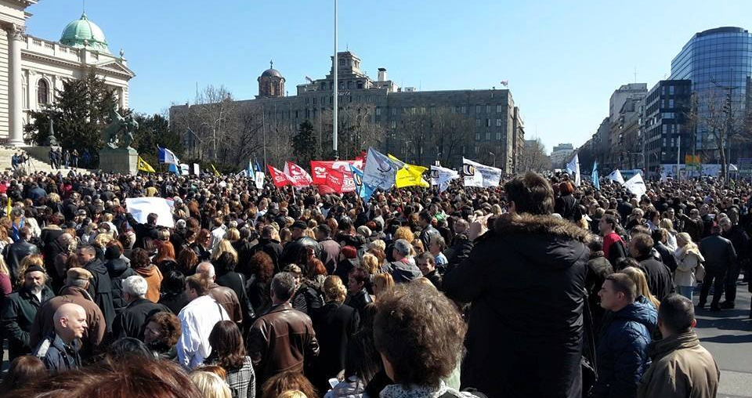
Teachers demonstrate in Belgrade Tuesday 16 March 2015

